Slide 1
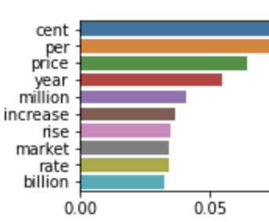
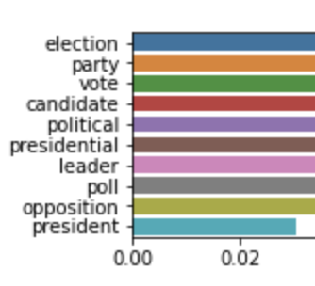
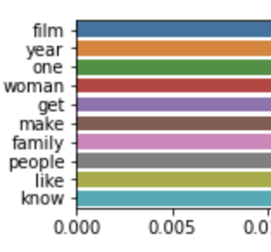
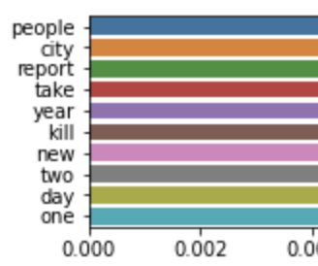
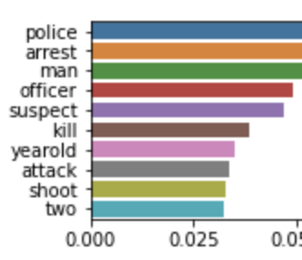
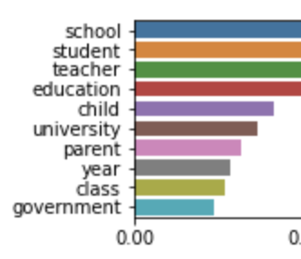
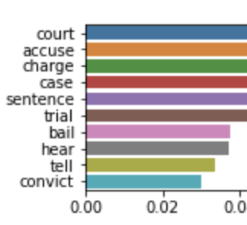
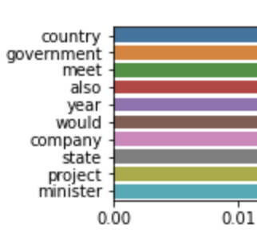
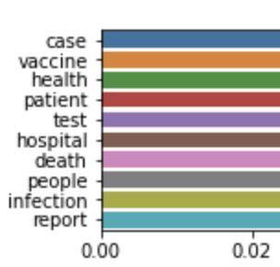
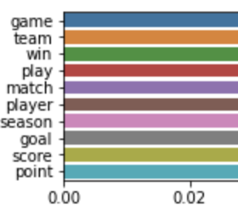
Class 1:
Economy/Market
Class 5:
Election
Class 9:
Film
Class 2:
Report
Class 6:
Violence/Crime
Class 10:
Education
Class 3:
Litigation
Class 7:
Government views
Class 4:
Health
Class 8:
Sports

Slide 2
XLNet Model
High Peace
Low Peace

Slide 3
Bert Model for Twitter
High Peace
Low Peace

Slide 4
XLNet Model with only noun in text

Slide 5
XLNet Model with shuffle text

Slide 6
Logistic Model

Slide 7
Logistic Model with only noun in text

Slide 8
Logistic Model with shuffle text

